Slide 1
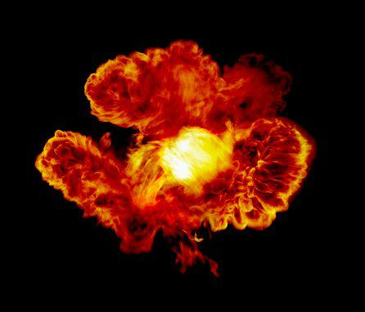
Flame War
Flame War
fffffffffffffffffffffff

Slide 2
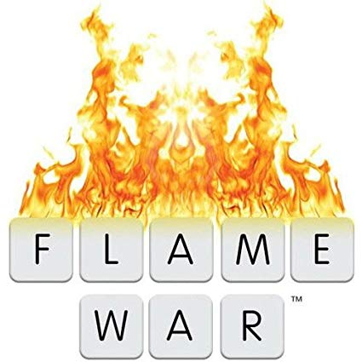
Do you know what is a
Flame War?

Slide 3
Ok, a flame war is…
A flame war is an online discution exchanging insulting and agresive masseges and images which can have 2 or more users in the web site, game or appa

Slide 4
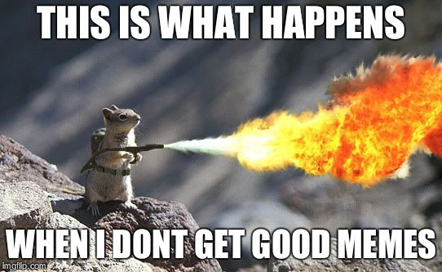
What is a
Flame War

Slide 5
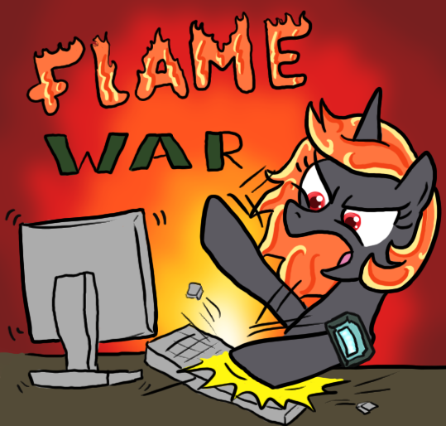
Have you ever experienced a
  Flame War?

Slide 6
Tips…
Blok users that insult you on line
Go out of insulting conversations
Do not insult other users any way its possible

